Slide 1
Investment Case Study Submission
Individual Name: Priyanka Navgire

Slide 2
Business Objective And Strategy
Spark Funds wants to make investments in a few companies. The CEO of Spark Funds wants to understand the global trends in investments so that she can take the investment decisions effectively.
Business Objective: The objective is to identify the best sectors, countries, and a suitable investment type for making investments. The overall strategy is to invest where others are investing, implying that the 'best' sectors and countries are the ones 'where most investors are investing'.
Major Criteria to consider: It wants to invest between 5 to 15 million USD per round of investment
It wants to invest only in English-speaking countries because of the ease of communication with the companies it would invest in.
Strategy for Analysis: Spark Funds wants to invest where most other investors are investing. This pattern is often observed among early stage startup investors.
Source of Data:
Crunchbase.com

Slide 3
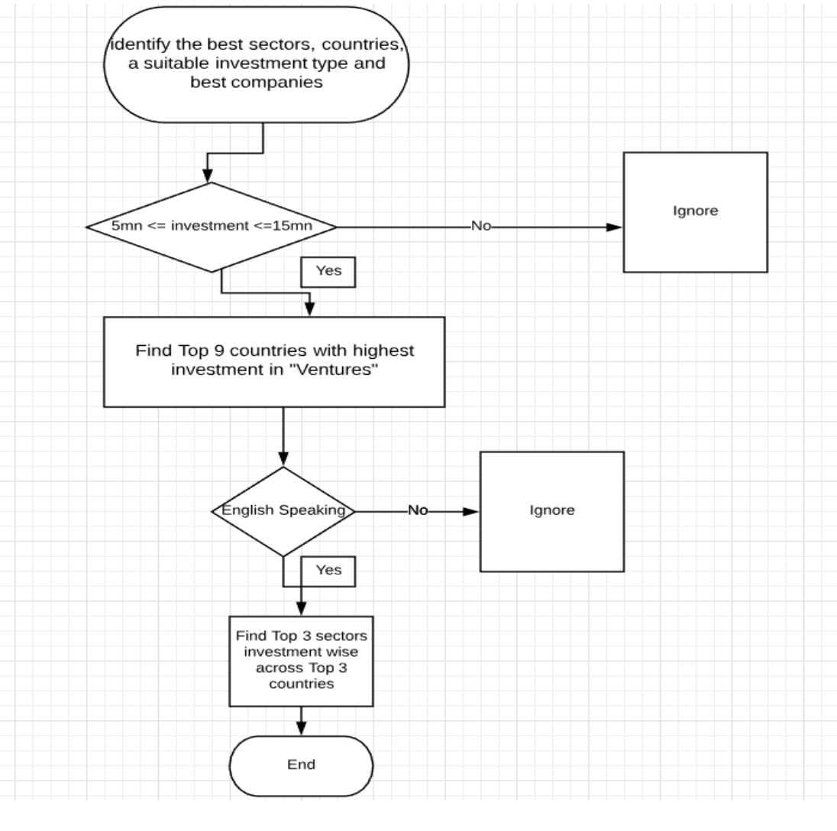
Problem solving methodology

Slide 4
Data Available for analysis
DATA SETS:
Company Text file: This has all Company details.
Rounds2 Data file: This has all funding related details of various companies.
Sector Data file: This file maps the numerous category names in the companies table to eight broad sector names. the purpose is to simplify the analysis into eight sector buckets, rather than trying to analyse hundreds of them.
Observation in the datasets Company and Rounds2:
The unique values permalink and company_permalink in the two datasets viz company and rounds2 respectively used as primary identifier for companies .
Which is further used to merge the data together which is used further for curating data based on the requirement specified.

Slide 5
Most Suitable Investment Type and Countries
Most suitable investment Type:
Venture was identified as the most suitable investment type because of the following reasons:-
Total number of investment for venture was the highest among the permissible limit between 5 and 15 million.
Total amount of investment for venture was between 5 and 15 million
Average funding investment
Most suitable countries to invest:
We identified the top 9 countries having maximum investment for Venture funding.
The three Top English speaking country was identified to be:-
United States America - USA
United Kingdom - GBR
India - IND

Slide 6
Sector Analysis
Rows with NANs were removed by filtering data by given criterias and then used further for processing.
Columns which were not used for the data analysis were dropped and then used further for processing..
The mapping.csv that we received was corrupted and was fixed through code. Which changed the overall result.
Category list with multiple values with a separator was simplified by considering the first value and was created as a new column called primary_sector. Which was further mapped to 8 main sectors to simplify the analysis.

Slide 7
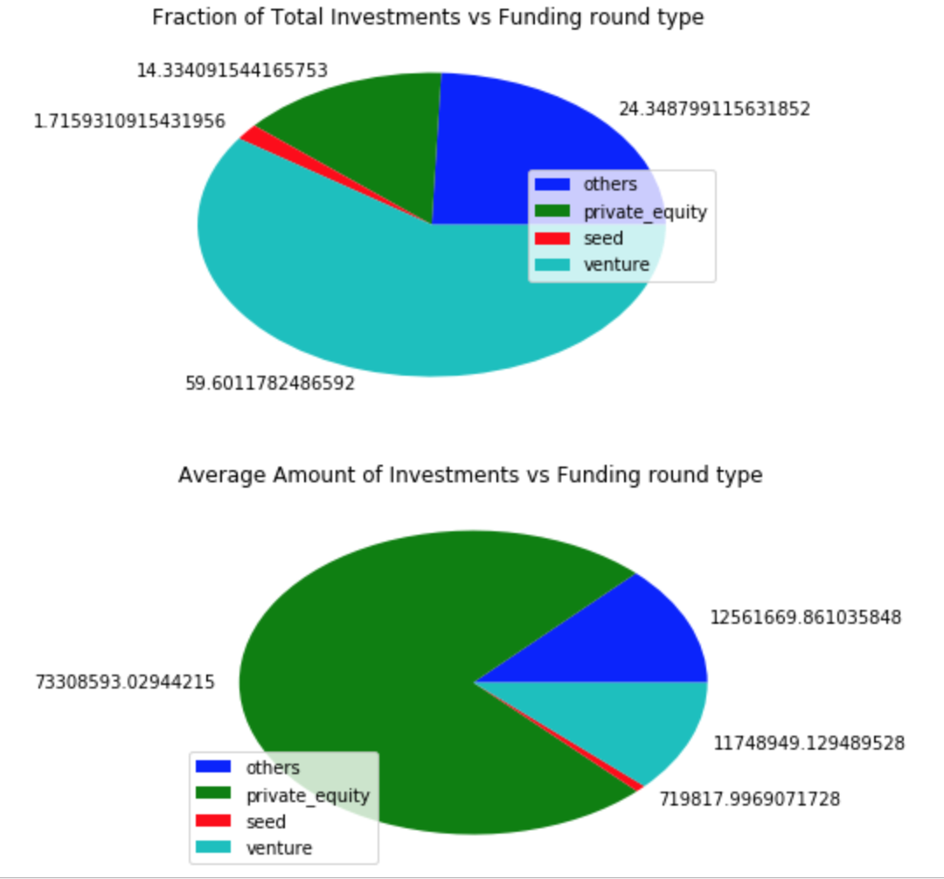
Funding Type vs Fraction of total Investments and Average Amount of Investments (Plot-1)

Slide 8
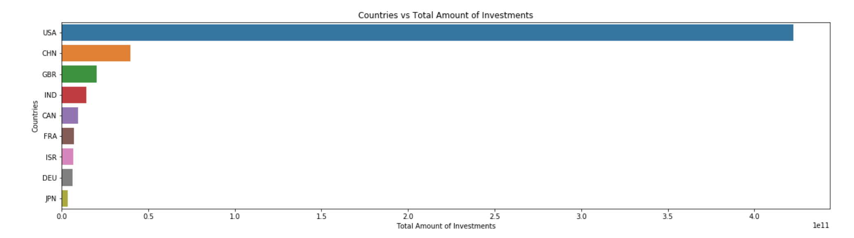
Top 9 Countries vs Total Amount of Investments(Plot-2)

Slide 9
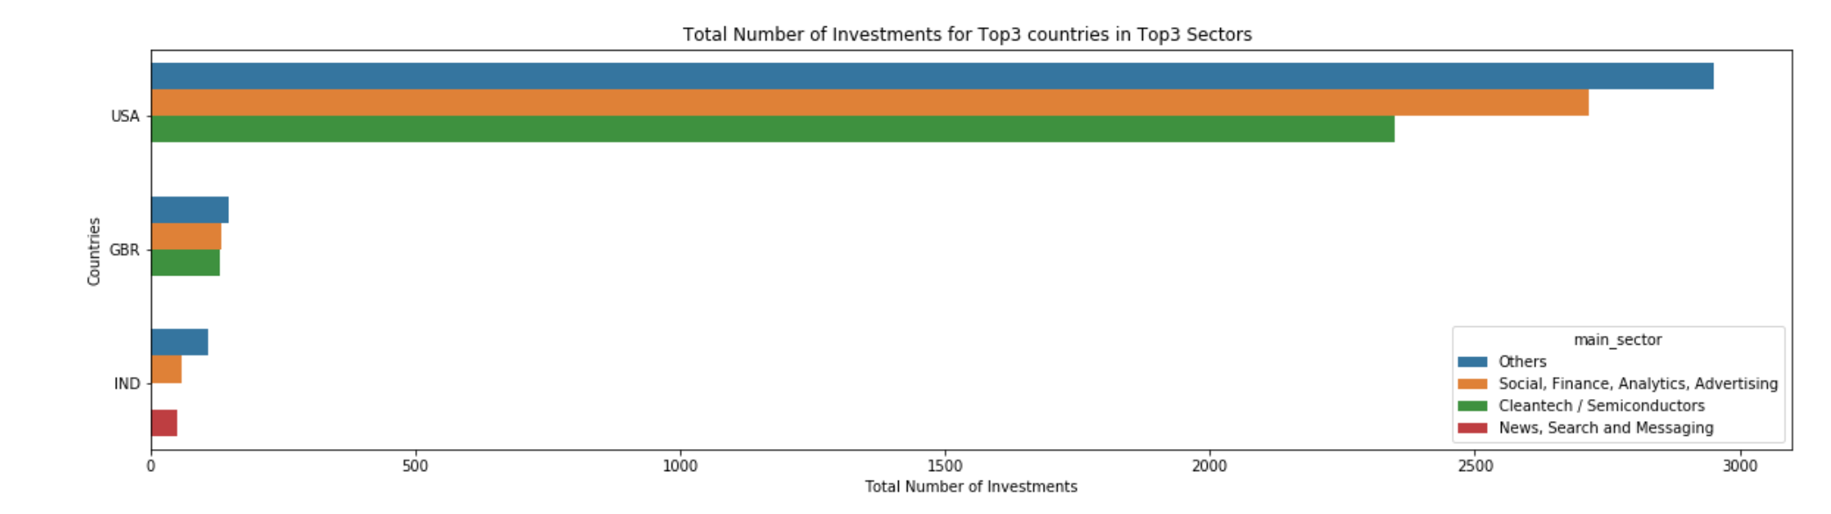
Total Number of Investments for Top3 countries in Top3 Sectors (Plot-3)

Slide 10
Conclusion
From Plot-1 we observe that Funding Type vs Total investments ploting among Seed, Venture, Private Equity and Other remaining funding types. Funding Type Venture has approximately 57% of the total investments between 5 million to 15 million. So with this we can conclude that Venture is the appropriate funding type in which we should invest.
From Plot-2 which is between Top9 Countries and Total Amount of Investments. We notice that USA, UK(GRB) and India(IND) with English as their official language are on first, third and fourth position as most invested countries in Venture funding type. So Appropriate country to invest in would be USA.
From Plot-3 which is about Total Number of Investments for Top3 countries in Top3 Sectors, we observe that leading Country USA has maximum number of Investments in sectors -Others, Social/Finance/Analytics/Advertising and Cleantech/ Semiconductors. With maximum number of investments in sector Others.
So overall most invested funding type is Venture, country is USA, and sector is Others.

